Slide 1

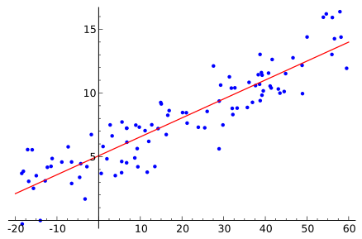


Regression Analysis - Social Networks

Slide 2
AGENDA
Business Overview
Modeling Strategy
Variable Description
Descriptive Statistics - Correlation
Linear Regression : Single & Multiple Variable
Variable Transformation
Model Validation
Conclusion

Slide 3
Business Problem
Company X is a marketing research firm that collects and maintains data for Celebs across US and India
Celebs wants to reach out to maximum followers through Social Networks for promotional activities for their movies, product endorsements etc.
Most of the Celebs for which company X maintains data are on twitter but not on facebook, Company X will help celebs to predict the number of facebook likes a celeb page will receive through linear regression model when a celeb creates a facebook page.

Slide 4
Modeling Strategy
Perform Descriptive Statistics to understand the correlation among all the variables
Exhaustive Search using LEAPS to generate best 6 subsets of linear models out of 63 Models.(2^6 -1 )
All Models we have built have CI = 95 %,ME = 5 %
Statistics Measures used to evaluate each Model
- AIC, Mallows CP, R-Square,Adjusted R-Square,VIF.
Ensure there is no violation of Variance , Normality, Linearity and Independence.
Breusch-Pagan (BP) test for Heteroscedasticity.
Variable Transformation to achieve constant variance.
Validation of the Regression Model

Slide 5
Variable Description
No | Parameter Name | Meaning
1 | Facebook Likes (Y) | Count of the number of followers liking the Celebrity page on Facebook.
2 | Age(X1) | Age of the Celebrity
3 | Number of followers(X2) | Number of followers for the Celebrity on Twitter
4 | Number of listed(X3) | Number of time the Celebrity is tagged by other users on Twitter
5 | Total Retweets(X4) | Number of time the Celebrity Tweet is retweeted by other users on Twitter
6 | Total Favorites(X5) | Number of likes each Celebrity Tweet receives
7 | Country(X6) | US or India – Only Categorical Variable

Slide 6
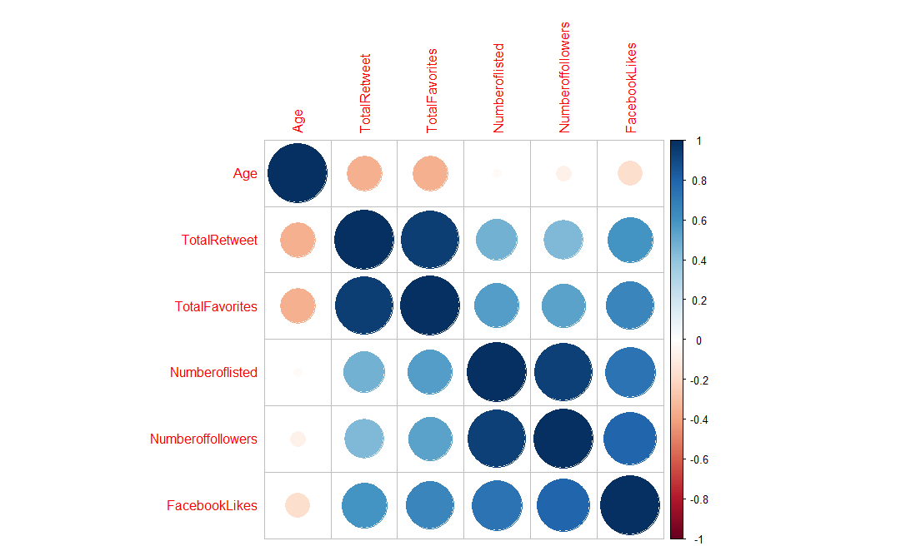
Correlation between
Variables
Parameters | Age | TotalRetweet | TotalFavorites | Numberoflisted | Numberoffollowers | FacebookLikes
Age | 1 | -0.354395 | -0.352621 | -0.02301995 | -0.072425 | -0.1742424
TotalRetweet | -0.3544 | 1 | 0.946708 | 0.479598 | 0.4478789 | 0.5958577
TotalFavorites | -0.3526 | 0.946708 | 1 | 0.55796684 | 0.5357931 | 0.6583138
Numberoflisted | -0.023 | 0.479598 | 0.557967 | 1 | 0.9378948 | 0.7314523
Numberoffollowers | -0.0724 | 0.447879 | 0.535793 | 0.93789477 | 1 | 0.7998733
FacebookLikes | -0.1742 | 0.595858 | 0.658314 | 0.73145231 | 0.7998733 | 1

Slide 7
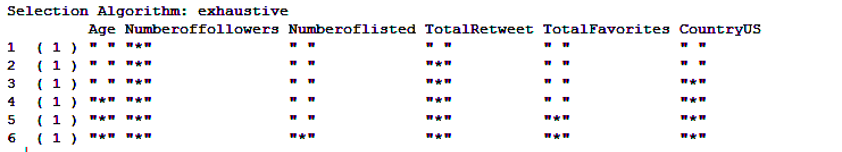
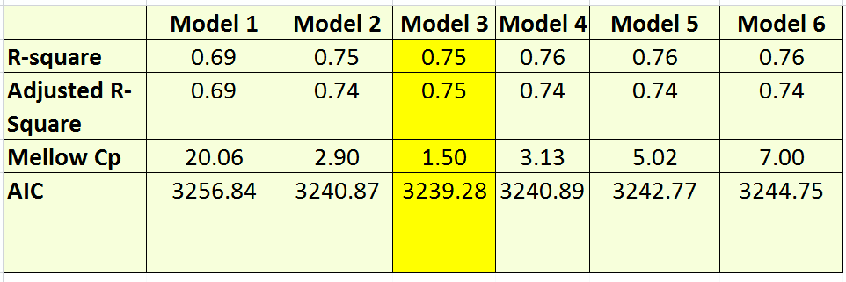
Top 6 Models from Exhaustive Search & Model Selection Criteria Metrics
Notes:
We have 6 variables, 63 (2^n -1) we used the leap package of r
few metrics of models
optimal model - 3

Slide 8
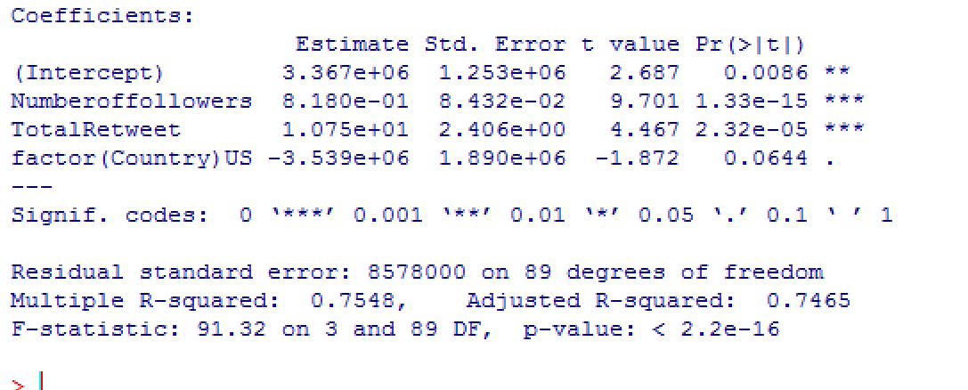
Linear Regression Model 3
FacebookLikes ~ Numberoffollowers+TotalRetweet+Country
Conclusion : Country is not a significant predictor as the P value is > than Alpha(0.05) and it’s not contributing significantly to predict Facebook Likes(Y).
Notes:
variables no of followers, total retweet, country
remove country from potential predictor of fb likes

Slide 9
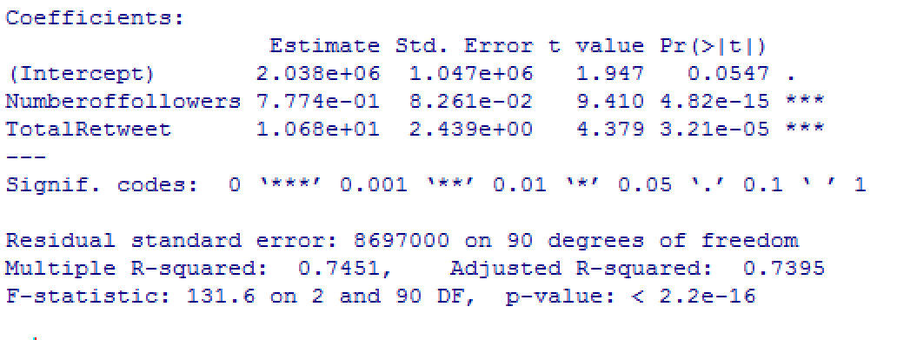
Linear Regression Model 2
FacebookLikes ~ Numberoffollowers+TotalRetweet
VIF : 3.92 (<10) which indicates that multicollinearity amongst all the variables is not overfitting the model.
Notes:
better output when we remove country out of the variables

Slide 10
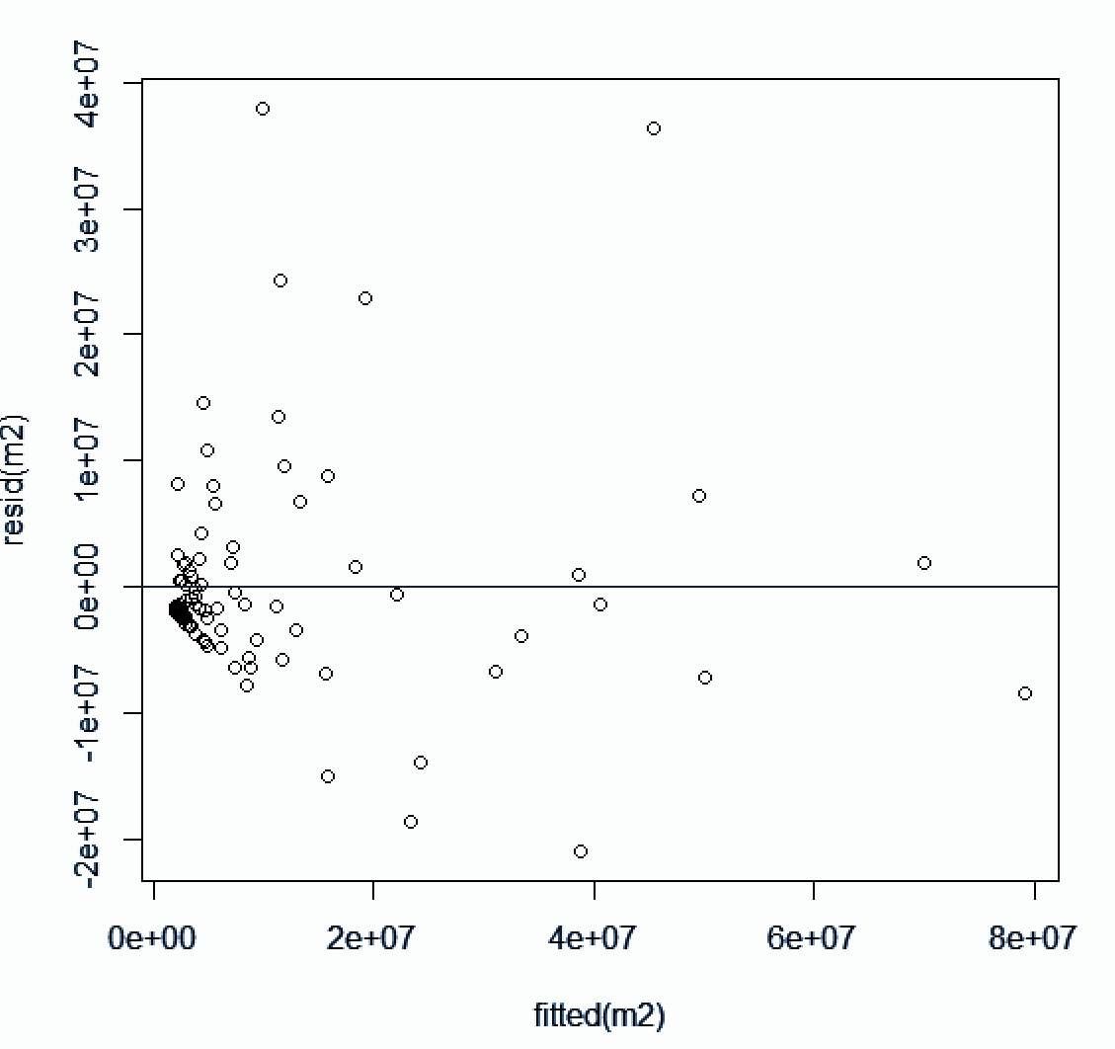
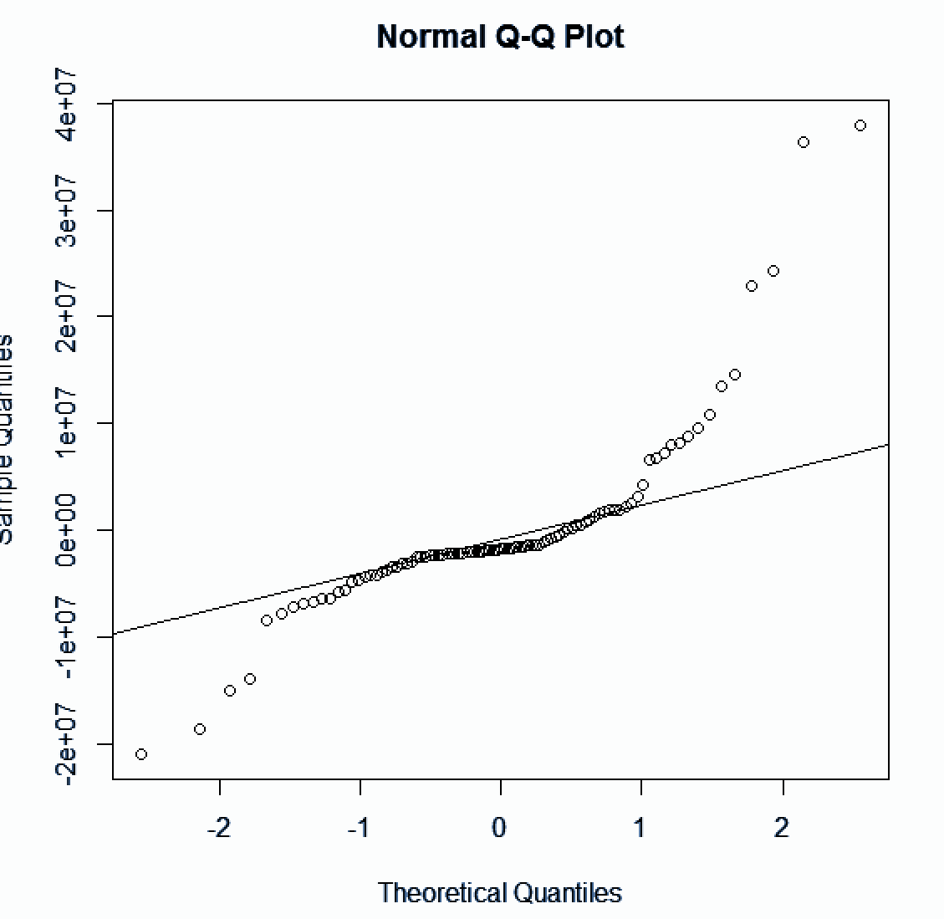
Model 2 - Plots
Residual vs Fitted QQ Norm Plot
Notes:
Quantile plot has heavy tail
no constant variance in residual vs fitted

Slide 11
Model 2
Breusch- Pagan Test : Test of Heteroscedasticity
H0 : Both Group have constant variance
H1 : Both Group do not have constant variance
Decision Rule : After running BP test if P value less than Alpha (0.05) Reject H0 else Fail to Reject H0
Results : P Value : 0.009837 < Alpha(0.05)
Conclusion : Reject H0

Slide 12
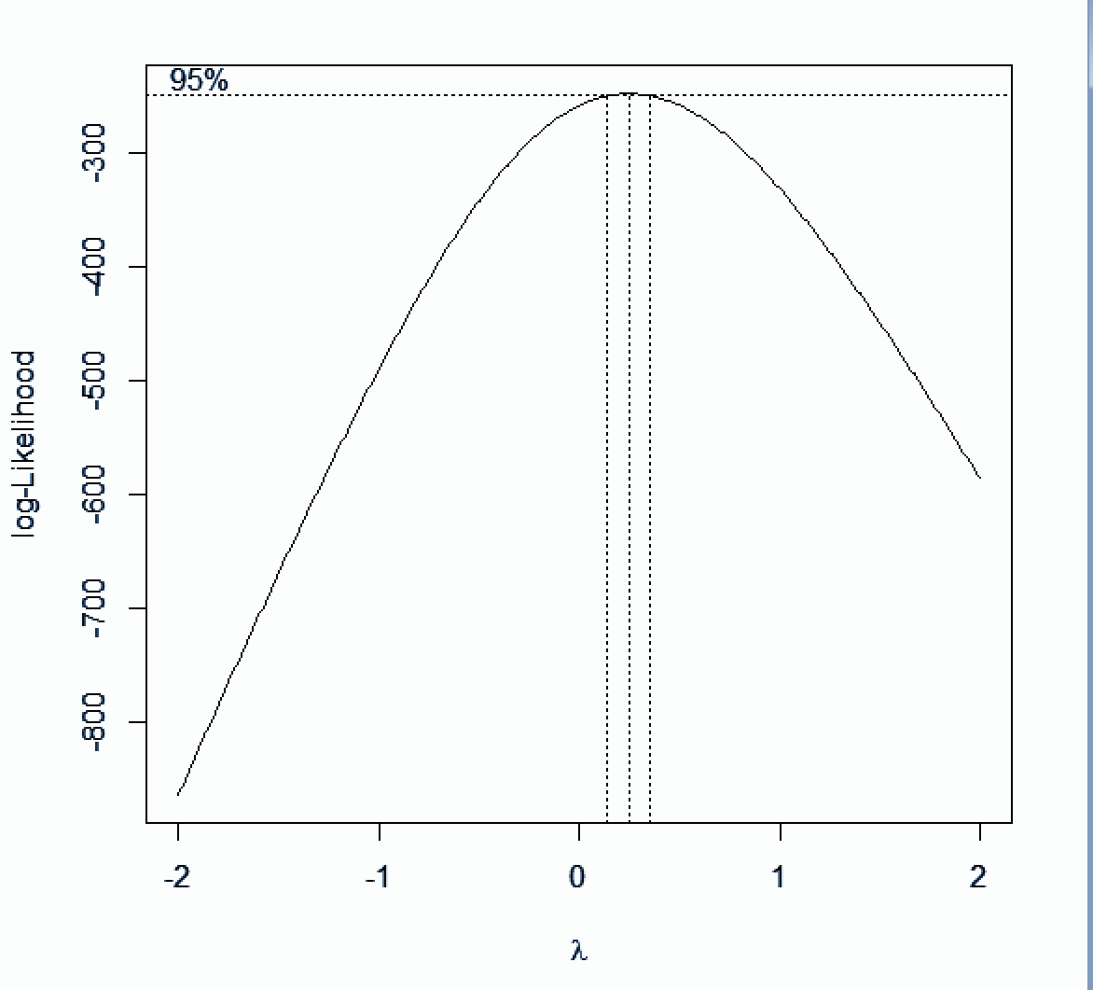
Transform (Y) : Using Box-Cox Plot
Lambda = 0.25

Slide 13
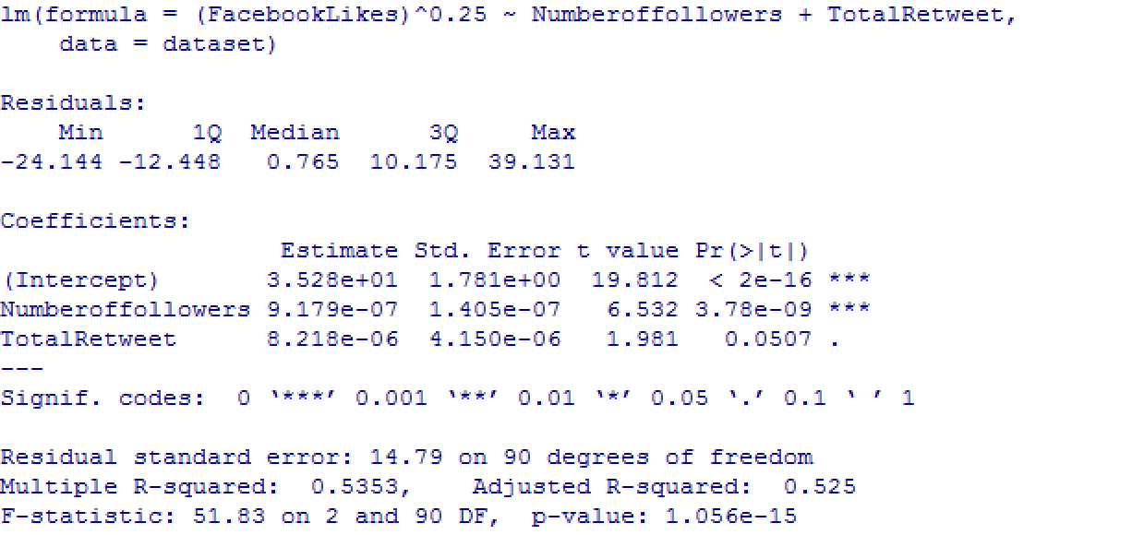
Model 2.1 : Transform Y to Y^0.25
P- value for TotalRetweet(0.0507) is marginally greater than the Alpha (0.05).
Notes:
We have seen that our lamda was 0.25 so we have power transformed our Y to ¼
The output of P-value for total retweet is more than alpha 0.05 for total retweet,
hence we would like to conclude that total retweet might not exactly be a best predictor for our regression model
Hence we conclude that Box-Cox transformation does not help solving Heteroscedasticity.

Slide 14
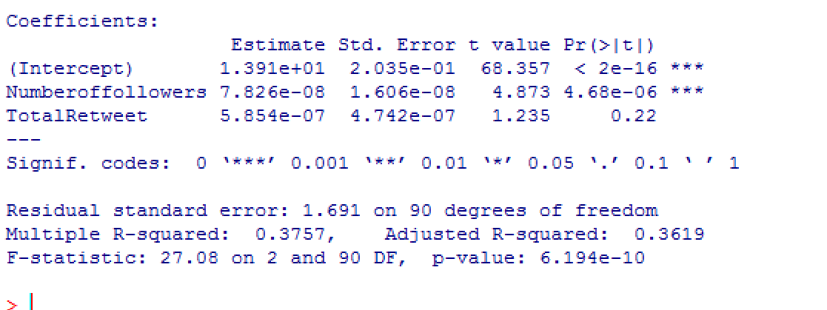
Model 2.2 : Transform Y to Log(Y)
P- value for TotalRetweet(0.22) is greater than the Alpha (0.05).
Notes:
as you have seen in our model 2.1, our power transformation was not helping us, so we tried to perform a log transformation.
We are essentially trying to see if the log(Y) is a better fit, but we see that the P - value of total retweet is still higher than our alpha,
so we think that total retweet is not a best predicting independent variable for our regression.
Hence we conclude that LOG transformation does not help solving Heteroscedasticity .

Slide 15
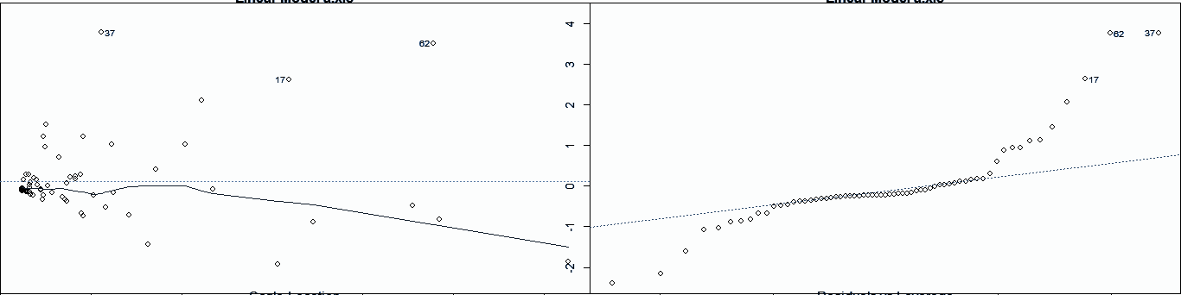
Model 1:Linear Regression (Single Variable) FacebookLikes(Y) ~ Numberoffollowers(X2)
Violation – Normality, Constant Variance
Residual Plot QQ NORM
Notes:
as we have seen so far, We can see that two variable model or 3 variable model is not helping us predict the fb likes,
we are going to use a single variable number of followers as given by leaps as best predictor,
we also noticed that there is a highest correlation between no of followers & fb likes
residual plot - variance is non constant, even in QQ plot distribution is not normal.
so there is a violation of variance in residual plot, and violation of normality in quantile plot.

Slide 16
Model 1
Breusch- Pagan Test : Test of Heteroscedasticity
H0 : Homoscedasticity
H1 : Heteroscedasticity
Decision Rule : After running BP test if P value less than Alpha (0.05) Reject H0 else Fail to Reject H0
Results : P Value : 2.229e-05 < Alpha
Conclusion : Reject H0
Notes:
although we see that there are violations in the graphs, we want to confirm the same using breush pagan test to test for hetero scedasticity
our H0 is homoscedastic
conclusion is reject Ho so we have a problem of hetero scedasticity

Slide 17
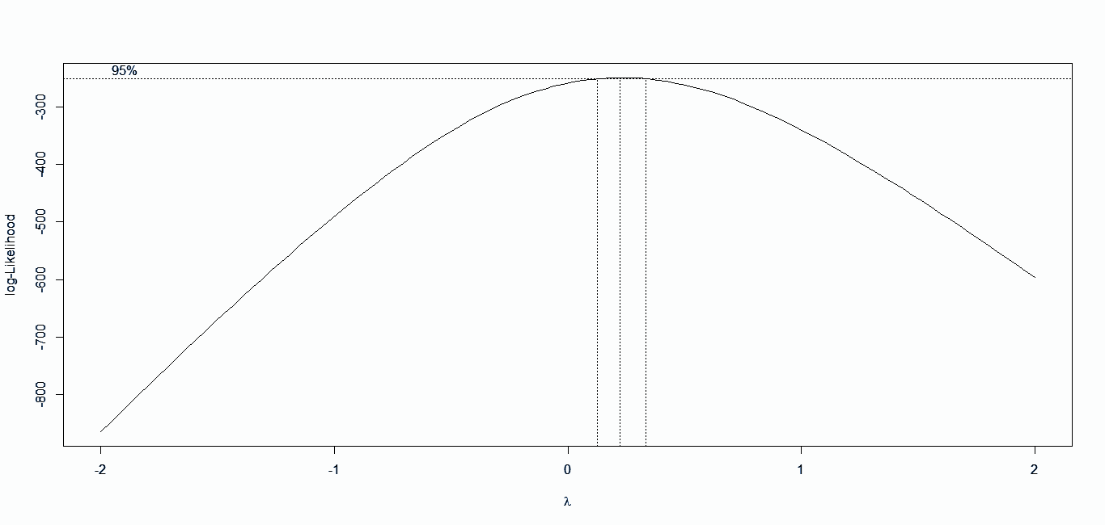
Model 1.1 :Variable Transformation
BOX-COX used for Y Transformation
λ = 0.25, Y Transform = POWER ( Y, 0.25 )

Slide 18
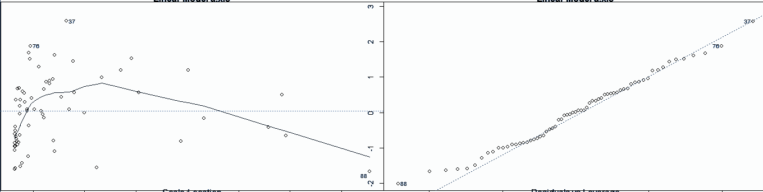
Model 1.1: Plots
Violation - Constant Variance
Residual Plot QQ Norm

Slide 19
Model 1.1
Breusch- Pagan Test : Test of Heteroscedasticity
H0 : Homoscedasiticity
H1 : Heteroscedasticity
Decision Rule : After running BP test if P value less than Alpha (0.05) Reject H0 else Fail to Reject H0
Results : P Value : 0.9045 >Alpha
Conclusion : Fail to Reject H0

Slide 20
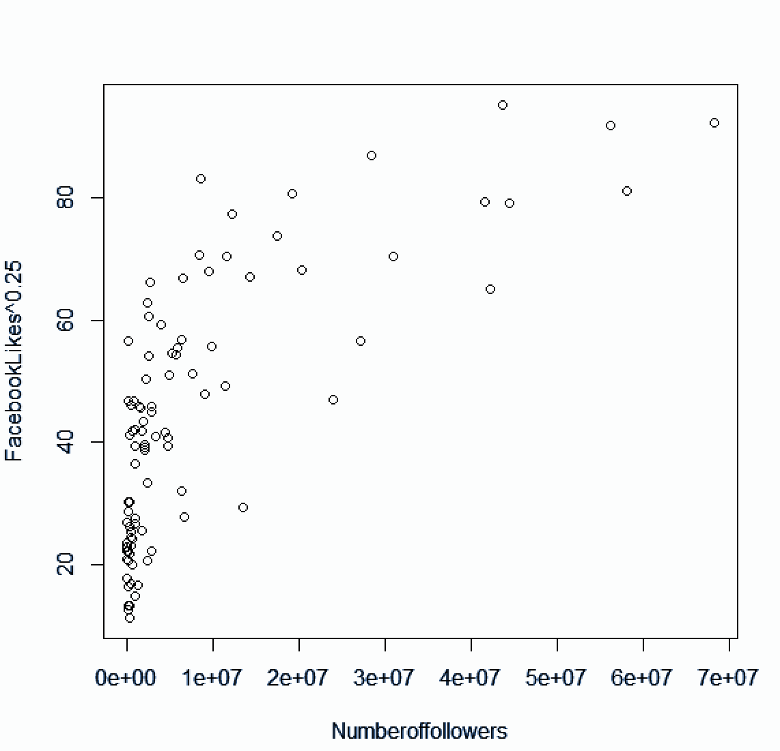
Model 1.1 :
Scatterplot (FacebookLikes ^0.25 ~ Numberoffollowers)
The scatter plot shows a curvilinear relationship between X and Y axis.

Slide 21
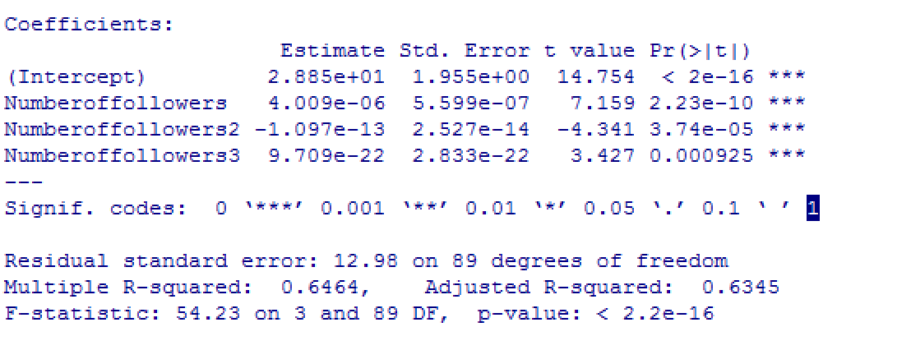
Model 1.2 : Transforming X to Polynomial form of X
FacebookLikes^0.25 ~ Numberoffollowers + Numberoffollowers^2 + Numberoffollowers^3

Slide 22
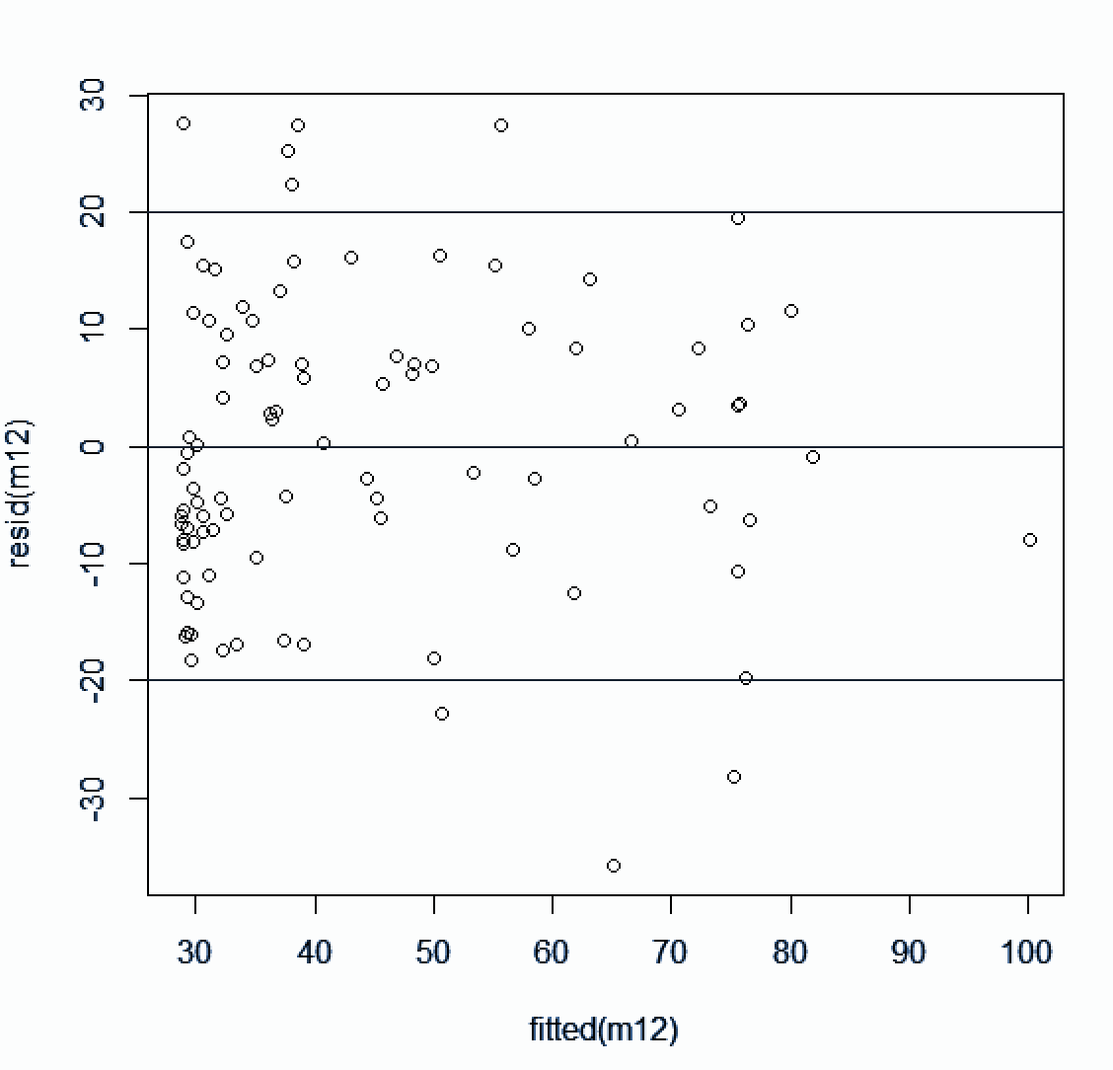
Model 1.2 :Residual vs Fitted Plot
CONSTANT VARIANCE FOR MODEL 1.2

Slide 23
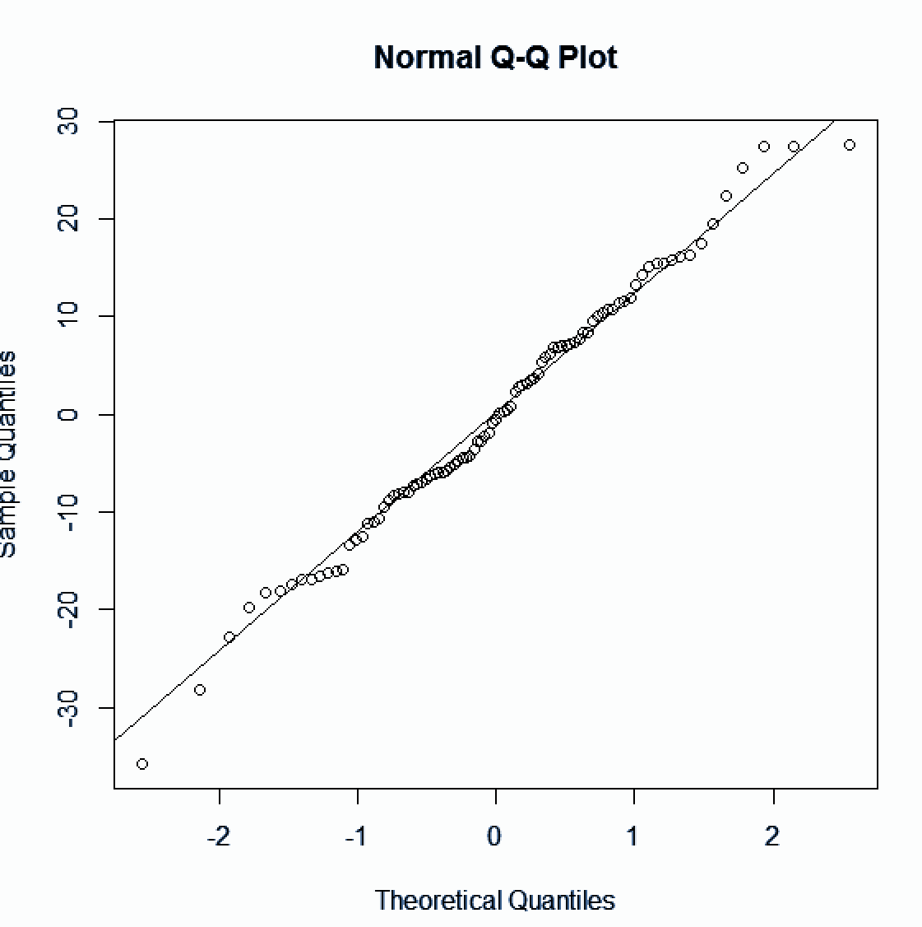
Model 1.2 :Quantile Plot

Slide 24
Model 1.2
Breusch- Pagan Test : Test of Heteroscedasticity
H0 : Homoscedasticity
H1 : Heteroscedasticity
Decision Rule : After running BP test if P value less than Alpha (0.05) Reject H0 else Fail to Reject H0
Results : P Value : 0.2844 >Alpha
Conclusion : Fail to Reject H0

Slide 25
Final Linear regression model
βo = 28.85
β1 = 4.009e-06
β2 = -1.097e-13
β3 = 9.709e-22
(FacebookLikes)^0.25 =
28.85
+ (4.009e-06) * (Numberoffollowers)
- (1.097e-13) * (Numberoffollowers)^2
+ (9.709e-22) * (Numberoffollowers)^3

Slide 26
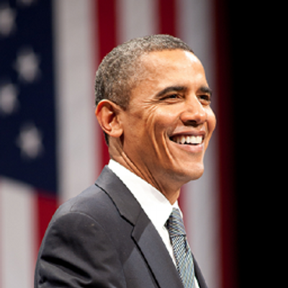
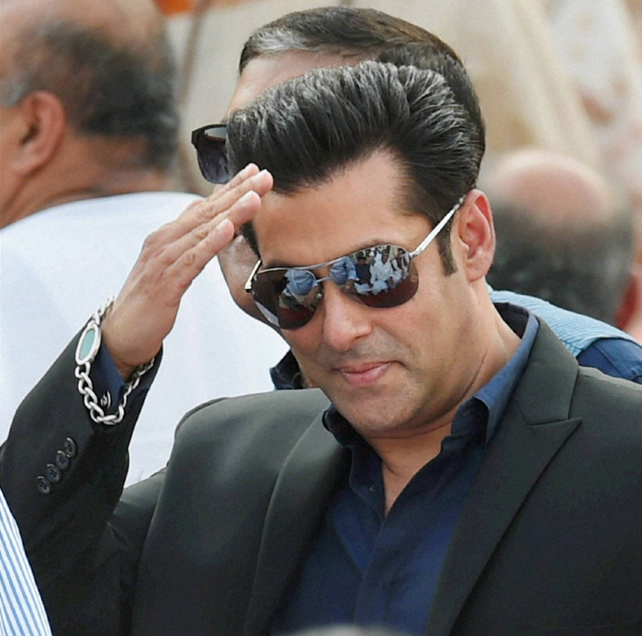
Validation of the Regression Model from
Sample Training data
Barack Obama
Salman Khan
FacebookLikes | Numberoffollowers | Actual Transformed Y | Estimated from Model Transformed Y | Error
43 million | 58 million | 81.86 | 80.94 | 2.38%
FacebookLikes | Numberoffollowers | Actual Transformed Y | Estimated from Model Transformed Y | Error
24 million | 11.5 million | 70.40 | 61.96 | 13.62%

Slide 27
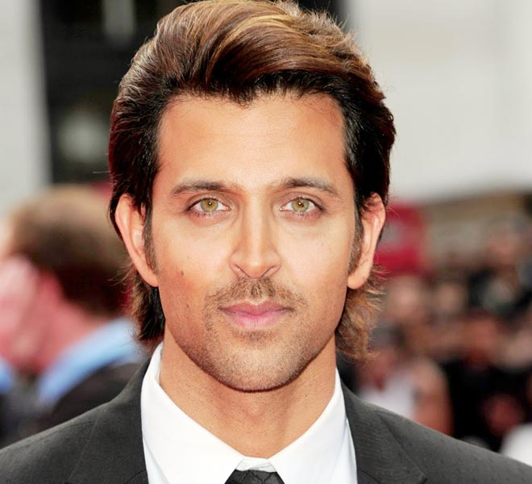
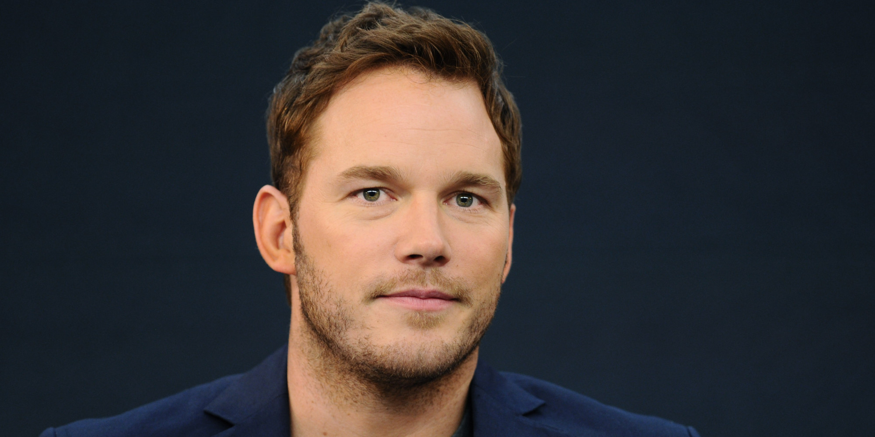
Validation of the Regression Model for Test Data
Hrithik Roshan
Chris Pratt
FacebookLikes | Numberoffollowers | Actual Transformed Y | Estimated from Model Transformed Y | Error
14.8 million | 9.6 million | 62.07 | 58.02 | 7%
FacebookLikes | Numberoffollowers | Actual Transformed Y | Estimated from Model Transformed Y | Error
11.8 million | 1.9 million | 32.98 | 36.14 | 8.76%

Slide 28
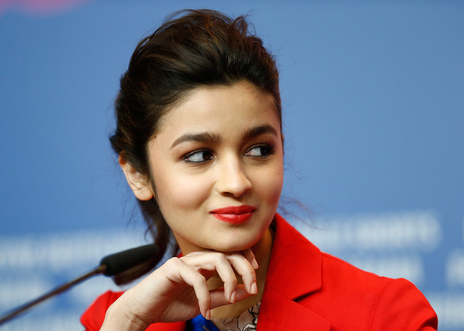
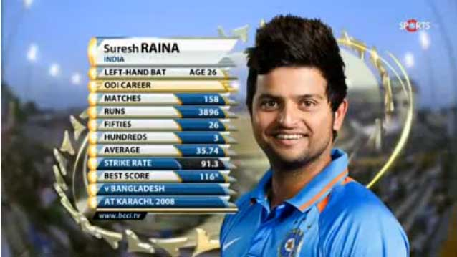
Predicting Output with 95 % CI and 5 % ME through Regression model for the celeb not on facebook but on twitter
Alia Bhatt
Suresh Raina
Number Of Followers in Twitter | Estimated (Y^0.25) | Expected Facebook likes
4.6 million | 45.24 | 4.2 million
Number Of Followers in Twitter | Estimated (Y^0.25) | Expected Facebook likes
3.8 million | 42.84 | 3.37 million

Slide 29
QUESTIONS

Slide 30
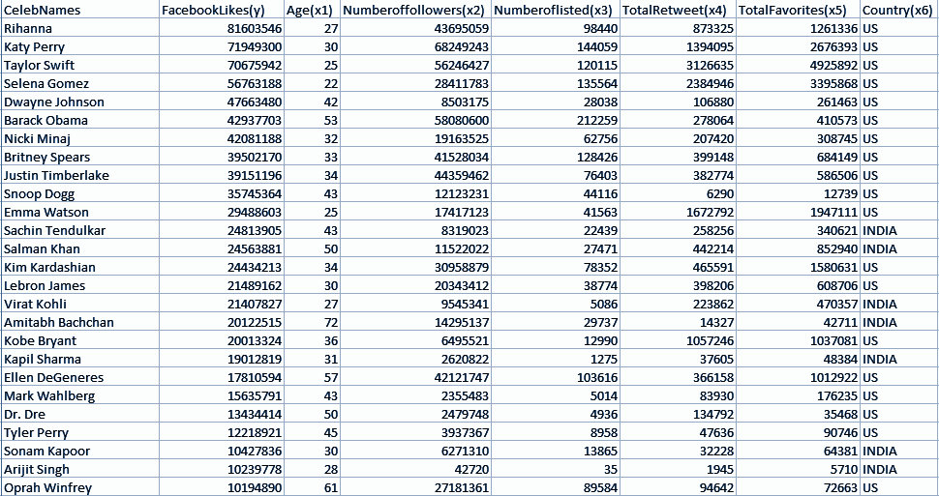
APPENDIX
Data Description

